Slide 1
OLIST STORE ANALYSIS
Domain : E-Commerce

Slide 2
Contents
Group Members
Objectives
Raw Data
Master Data
Pivot Tables
Excel Dashboard
Power-BI Dashboard
Tableau Dashboard
MySQL Queries
Key Findings
Insights

Slide 3
Group members
Yash Varma
Himani Kawale
Vishal Aswar
K. Chandra Kiran
Adineni Bhaskar
Ruban Raj

Slide 4
Objectives
Weekday Vs Weekend (order_purchase_timestamp) Payment Statistics
Number of Orders with review score 5 and payment type as credit card.
Average number of days taken for order_delivered_customer_date for pet_shop
Average price and payment values from customers of sao paulo city
Relationship between shipping days (order_delivered_customer_date - order_purchase_timestamp) Vs review scores.

Slide 5
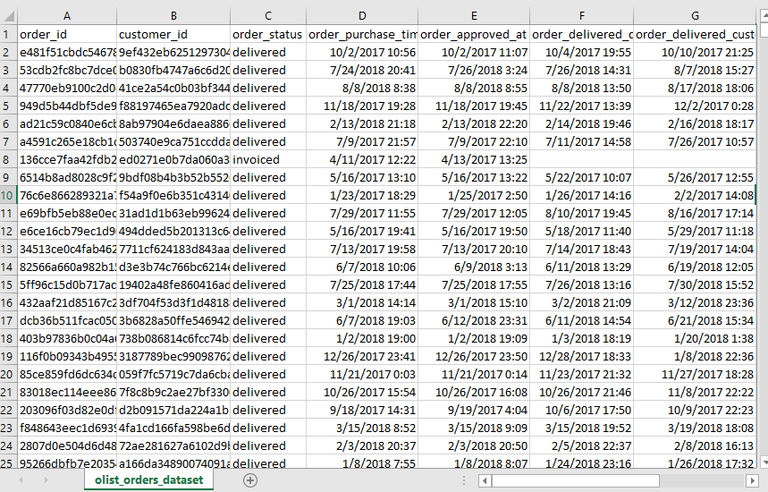
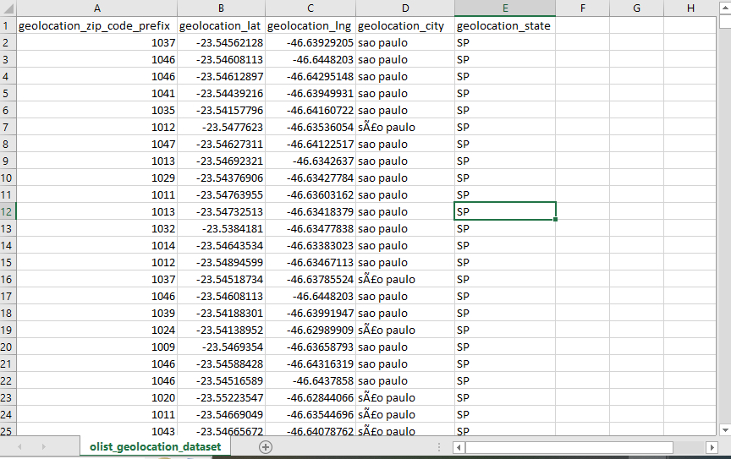
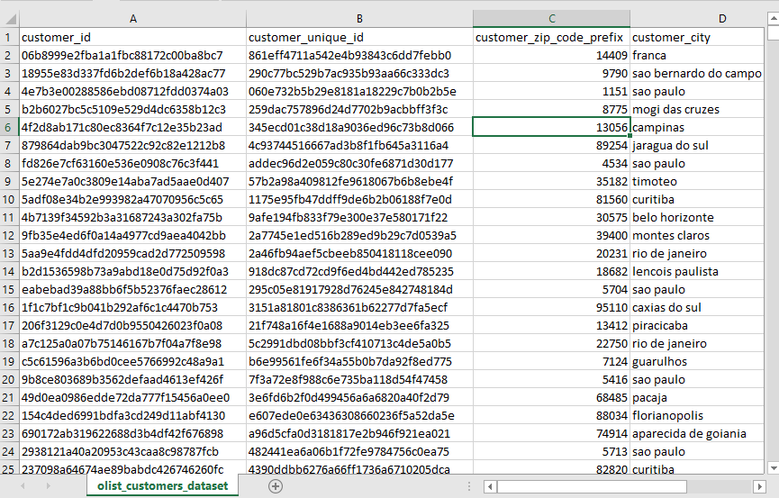
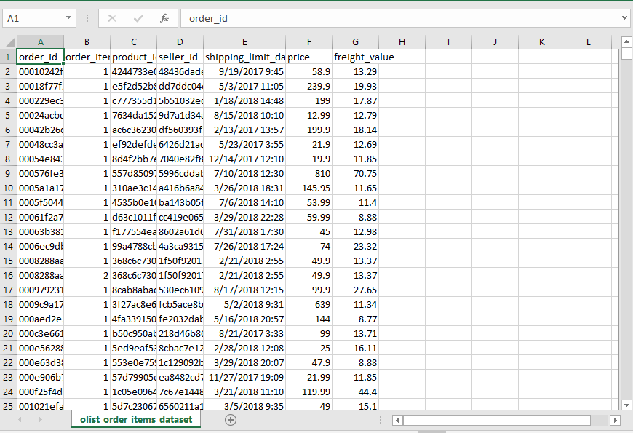
Raw Data
olist_orders_dataset
olist_geolocation_dataset
olist_customers_dataset
olist_order_items_dataset

Slide 6
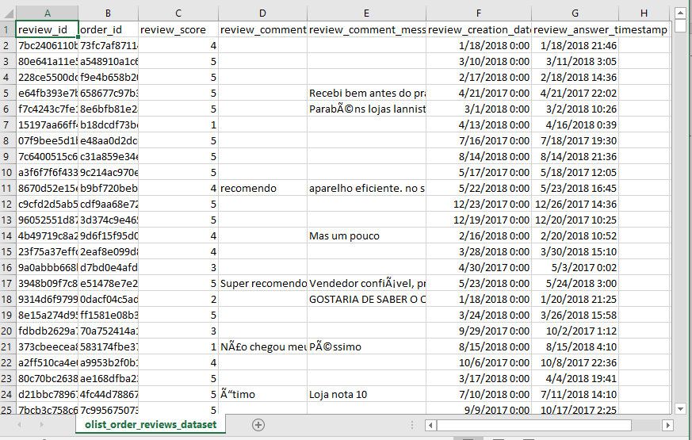
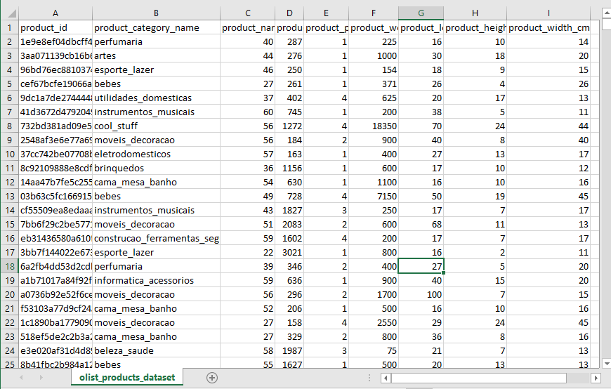
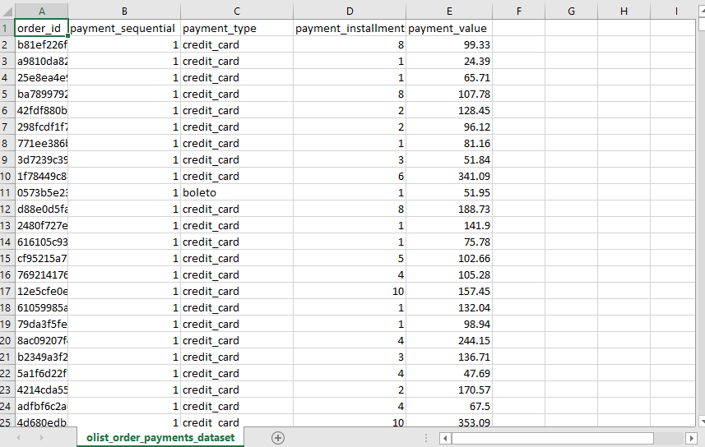
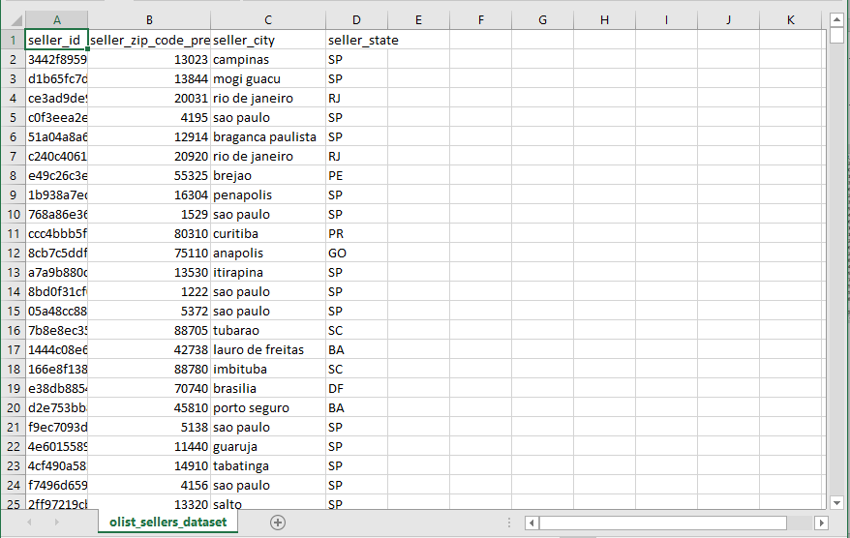
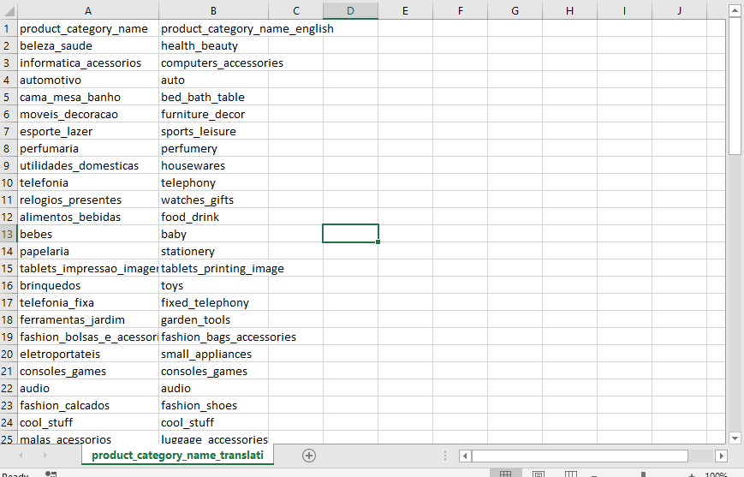
Raw Data
olist_order_reviews_dataset
olist_products_dataset
olist_order_payments_dataset
olist_sellers_dataset
Product_category_name_translation

Slide 7
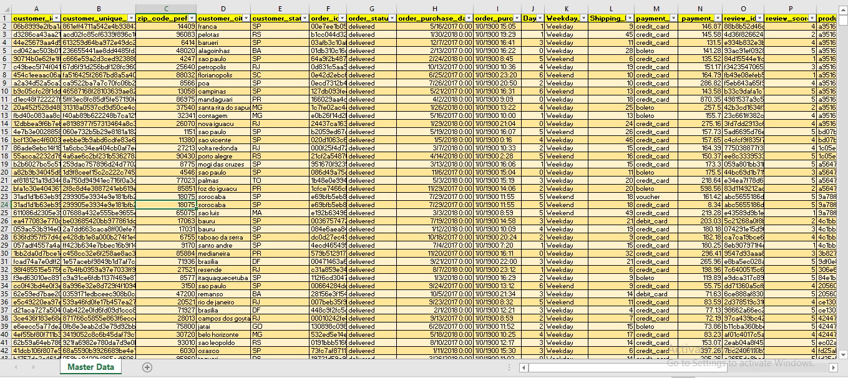
Master Data

Slide 8



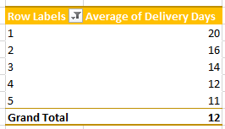

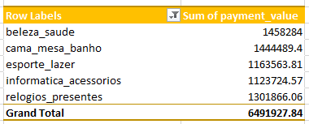
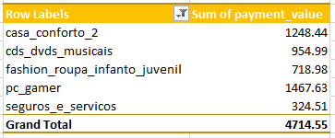
Pivot Tables

Slide 9
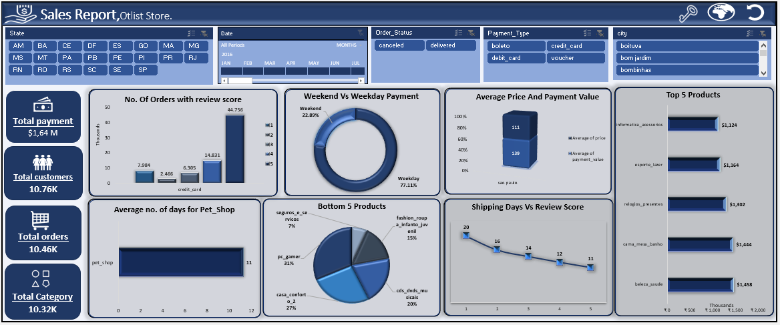
Excel Dashboard

Slide 10
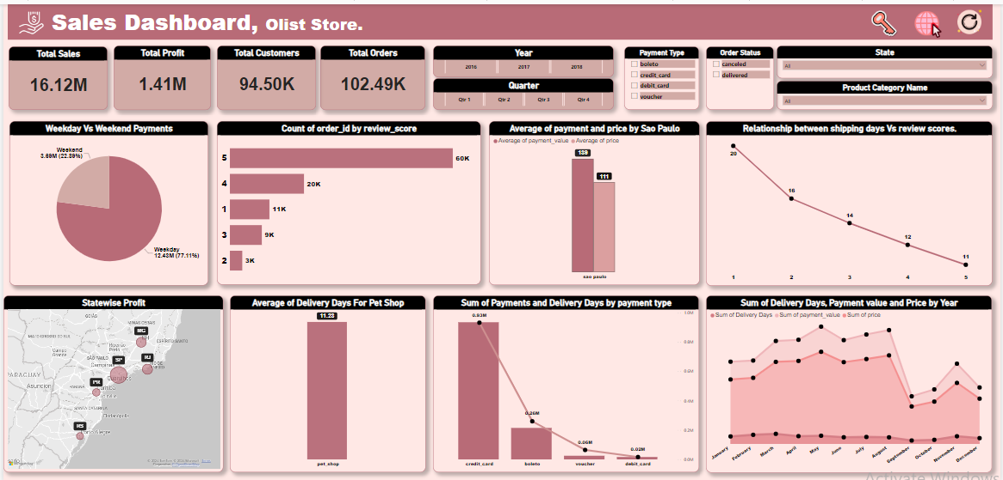
Power-BI Dashboard

Slide 11
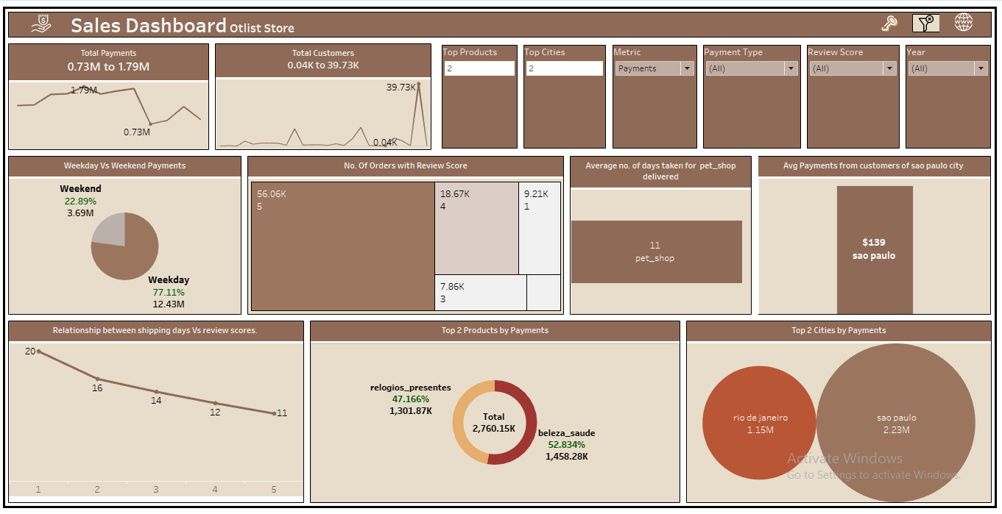
Tableau Dashboard

Slide 12
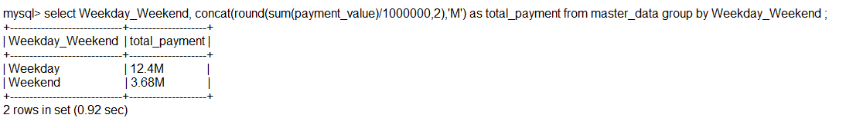
MySQL Queries
KPI 1: Weekday Vs Weekend (order_purchase_timestamp) Payment Statistics

Slide 13
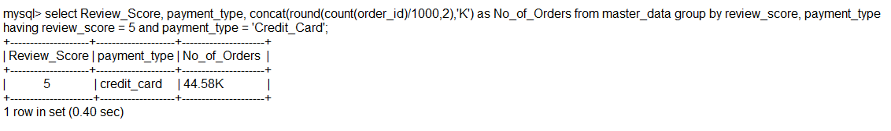
KPI 2: Number of Orders with review score 5 and payment type as credit card.

Slide 14
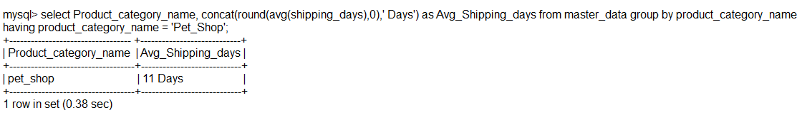
KPI 3: Average number of days taken for order_delivered_customer_date for pet_shop

Slide 15
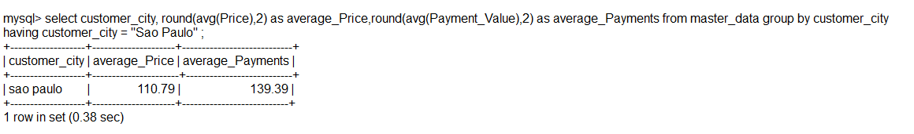
KPI 4: Average price and payment values from customers of sao paulo city

Slide 16
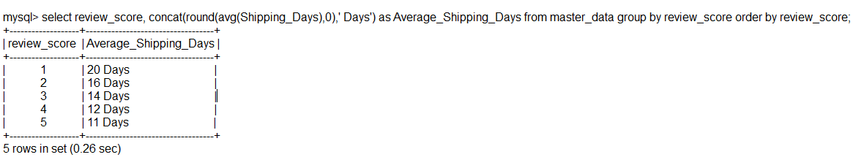
KPI 5 : Relationship between shipping days (order_delivered_customer_date - order_purchase_timestamp) Vs review scores.

Slide 17
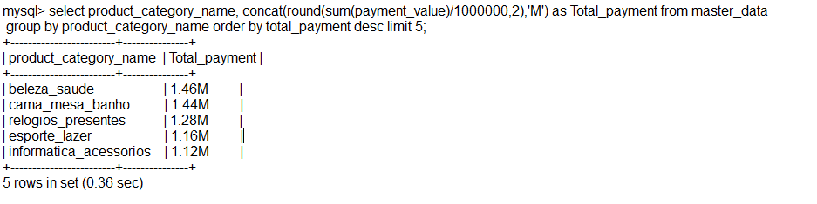
Top 5 Products by Payment

Slide 18
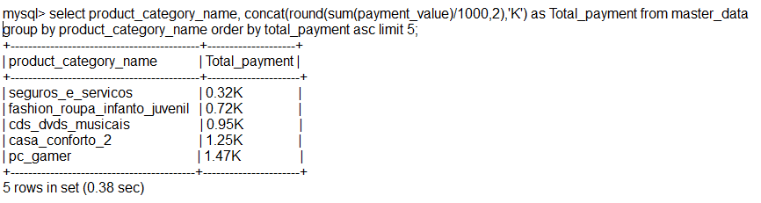
Bottom 5 Products by Payment

Slide 19
Key Findings
Sales: Total payments $1.64M from 10.46K orders, 10.32K categories sold with a diverse range of products.
Payment Methods: Credit cards dominate with 65.18K payments, suggesting potential for loyalty programs.
Customer Behavior: 77% of payments happen on weekdays, indicating higher sales activity during the week.
Top Region: Sao Paulo has the highest average transaction value ($159), indicating demand for premium products.
Shipping: Faster shipping leads to higher customer review scores, highlighting the importance of delivery efficiency.
Top Products: High sales for items like notebooks, phones, and sports gear.
Bottom Products: The least performing products in terms of payment includes Fashion_roupa_infanto_juvenil , PC_gamer, Casa_conforto, Seguros_servicos , Cds_dvds_musicas.

Slide 20
Insights
Product Focus: The top 5 products (Beleza_Saude, Cama_Mesa_Banho, Relogios_Presentes) are generating higher revenue. Focus more marketing and stock efforts on these products to maximize profits.
Payment Method Optimization: Credit card payments contribute significantly (as seen in the highest review scores and number of orders). Offering incentives for using credit cards could further boost sales.
Shipping & Customer Satisfaction: The review scores versus shipping days show a correlation. Ensuring faster shipping (ideally around 11–12 days or below) may result in higher customer satisfaction and improved review scores.
Weekend vs Weekday Sales Strategy: With 77% of payments made during weekdays, focus on increasing weekend sales by offering special promotions or discounts. This will balance the sales throughout the week and optimize resource utilization.
Bottom 5 Products Re-evaluation: Products such as “Seguros_servicos” and “PC_gamer” are underperforming, representing only 7% and 31% of the total, respectively. Consider whether to discontinue these products or re-strategize their sales through bundling or targeting specific customer segments.
City-wise Targeting: The report shows certain city-wise sales trends. Tailoring marketing strategies to the high-performing cities (like Sao Paulo) can drive better results.

Slide 21
Thank You

